Slide 1
Sales Performance Dashboard
Data Analyst Internship-Task 4
Prepared by : Adithyan A S
Tools Used:
Power BI Desktop
Microsoft Excel
Dataset: Financial Sample Dataset
Date: July 2026

Slide 2
OBJECTIVES
The objective of this project is to design an interactive business dashboard using Power BI. The dashboard helps business stakeholders monitor sales performance, analyze profits, identify product performance, and make informed business decisions using visual analytics.
Goals
Visualize sales performance.
Monitor profit across countries.
Analyze product-wise sales.
Compare sales by business segment.
Enable interactive filtering using slicers.

Slide 3
Dataset
Financial Sample Dataset
Dataset contains
Date
Year
Country
Product
Segment
Sales
Profit
Units Sold
Manufacturing Price
Sale Price
Discounts
Tools Used
Microsoft Power BI Desktop
Microsoft Excel
GitHub

Slide 4
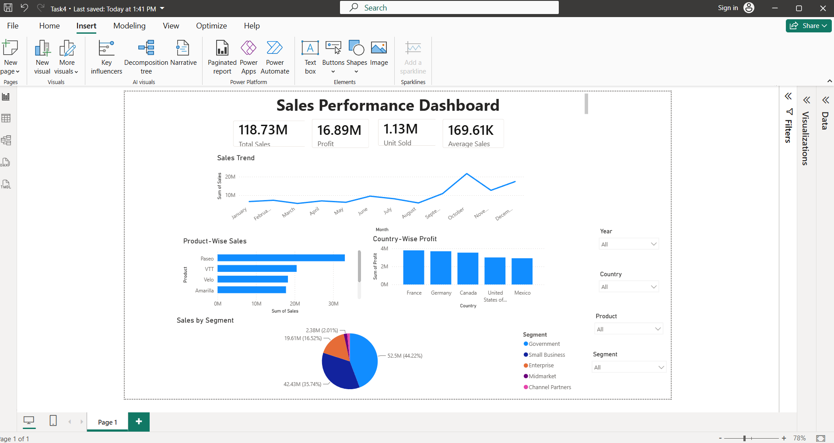
Dashboard Components
KPI Cards
Total Sales
Total Profit
Units Sold
Average Sales
Charts
Sales Trend (Line Chart)
Product-wise Sales (Bar Chart)
Country-wise Profit (Column Chart)
Sales by Segment (Pie Chart)
Interactive Filters
Year
Country
Product
Segment

Slide 5
Conclusion
The dashboard successfully provides an interactive overview of business performance. Using Power BI visualizations and slicers, users can quickly analyze sales, profits, products, and regional performance. The project demonstrates how dashboards support data-driven decision-making by presenting complex information in a simple and interactive format.
Future Improvements
Add monthly growth analysis.
Include forecast visuals.
Add navigation buttons.
Connect to live business data.
Publish the dashboard to the Power BI Service.

